Slide 1



Drupal Quick Start
Drupal Quick Start

Slide 2
Training Information
Instructor
Andargachew A.
Training Material
GitHub: https://github.com/contact-andy/Drupal-Quick-Start-Training

Slide 3
Agenda
Introduction to Drupal
Setting Up a Local Environment
Drupal Core Features & Content Management
Installing & Managing Modules
User Management
The Commerce Module
Configuring the Commerce Module
Managing Store & Products
Configuring Payment Options
Final Review & Q&A

Slide 4
Agenda
Introduction to Drupal
Setting Up a Local Environment
Drupal Core Features & Content Management
Installing & Managing Modules
User Management
The Commerce Module
Configuring the Commerce Module
Managing Store & Products
Configuring Payment Options
Final Review & Q&A

Slide 5
Introduction to Drupal
Drupal is a free and open-source content-management framework that can be customized and is suitable for developing simple websites or complex web applications.

Slide 6
Quick Facts
Installing and running Drupal is completely free.
Includes 40,000+ modules available to extend site functionality
2500+ themes used for modifying the site appearance
One of the largest open source communities in the world. (>1,000,000)
More than 5000 organizations (Amnesty International, University of Oxford , BBC, NBC, MTV UK, . . .)

Slide 7
Key Characteristics of Drupal:
Modular System: Add functionalities using modules
Highly Customizable: Offers themes and templates
Security-Focused: Regular updates and strong community support
Scalable: Suitable for small blogs to large enterprise websites
Open Source: Built with PHP and powered by a large developer community

Slide 8
Drupal’s Use Cases
Websites
Business & Corporate
Government & Nonprofit
News & Media
E-commerce Platforms
Education & Learning Portals
Social Networks & Community Portals

Slide 9
Drupal’s Architecture
Drupal follows a modular, layered architecture that enables customization and scalability.
Core Components:
Themes – Control the website's look and feel.
Modules – Add functionality (e.g., e-commerce, SEO tools).
Entities & Content Types – Manage structured content.
Blocks & Menus – Organize content layout and navigation.
Users & Permissions – Define roles and control access.
Database Layer – Uses MySQL, PostgreSQL, or SQLite.
Caching System – Improves performance by storing data temporarily.

Slide 10
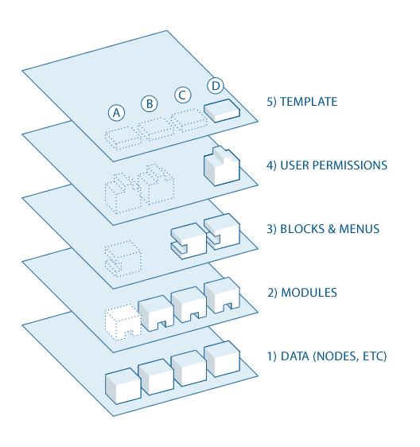

Slide 11
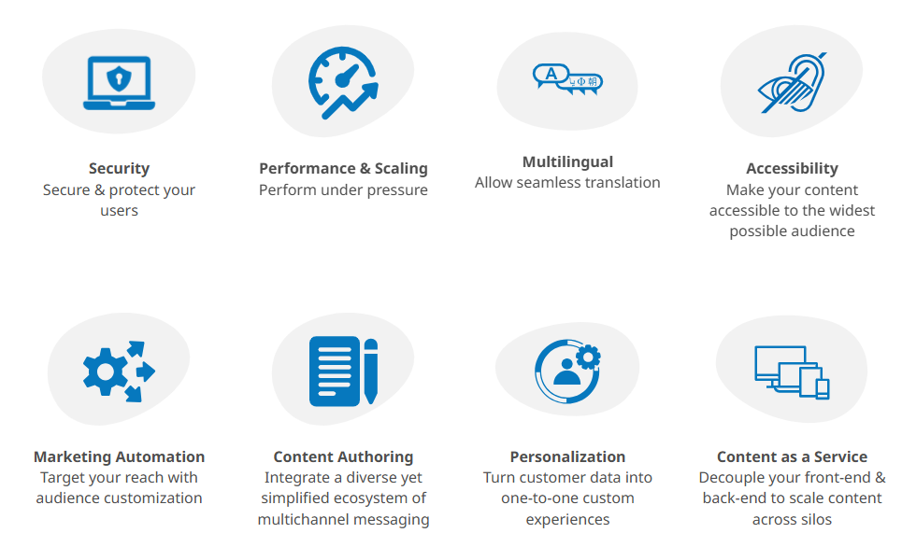

Slide 12
Agenda
Introduction to Drupal
Setting Up a Local Environment
Drupal Core Features & Content Management
Installing & Managing Modules
User Management
The Commerce Module
Configuring the Commerce Module
Managing Store & Products
Configuring Payment Options
Final Review & Q&A

Slide 13
Setting Up a Local Environment
The underlying 'stack'
A Drupal site needs a small 'stack' of software that works in the background to serve your site and store your content:
Server software
Database software
PHP interpreting software (Drupal is written in the PHP programming language.)

Slide 14


Slide 15
Agenda
Introduction to Drupal
Setting Up a Local Environment
Drupal Core Features & Content Management
Installing & Managing Modules
User Management
The Commerce Module
Configuring the Commerce Module
Managing Store & Products
Configuring Payment Options
Final Review & Q&A

Slide 16
Drupal Core Features & Content Management
Content Types in Drupal
Defines the structure and format of content.
Each content type consists of fields that store specific types of data.
Default Content Types in Drupal:
Article – For time-sensitive content (e.g., news, blogs).
Basic Page – For static pages (e.g., About Us, Contact).
Creating a Custom Content Type:
Navigate to: Admin > Structure > Content Types
Click "Add Content Type"
Provide a name and description
Configure settings (publishing options, display settings)
Save and manage fields

Slide 17
Fields in Drupal
Fields define the type of data that can be stored in a content type.
Common Field Types:
Text Fields – For titles, descriptions, and user input
Image Fields – For adding images to content
File Fields – For uploading documents
Date Fields – For events and scheduling
Entity Reference Fields – To link content to users, taxonomy terms, or other entities
Adding a Field to a Content Type:
Go to: Admin > Structure > Content Types
Click on “Manage Fields” for a content type
Click “Add Field”, select field type
Configure field settings (label, required/optional)
Click Save

Slide 18
Taxonomies in Drupal
Taxonomy is a system used to categorize and organize content.
It helps in creating tags, categories, and classifications.
Creating a Taxonomy Vocabulary:
Go to: Admin > Structure > Taxonomy
Click "Add Vocabulary" (e.g., Categories, Tags)
Click "Add Terms" to create new categories
Using Taxonomy with Content Types:
Edit a Content Type
Add a Term Reference Field
Link it to a vocabulary (e.g., Blog Categories)

Slide 19
Menus in Drupal
Menus help in structuring site navigation.
Managing Menus:
Go to: Admin > Structure > Menus
Select an existing menu (e.g., Main Navigation) or create a new one
Add a new menu link (Title, Path, Parent Item)
Save the menu
Customizing Menus:
Menus can be displayed in different regions of a theme
Menu items can be linked to nodes, views, or external URLs

Slide 20
Blocks in Drupal
Blocks are reusable content sections that can be placed in different regions of a website layout.
Creating a Custom Block:
Go to: Admin > Structure > Block Layout
Click "Add Custom Block"
Enter content, configure visibility settings
Place the block in a specific region
Using Blocks Effectively:
Use custom blocks for banners, announcements, or ads
Assign blocks to specific pages using visibility settings

Slide 21
Pages in Drupal
Pages are essential for static content such as About Us, Contact, and Services.
Creating a Page:
Go to: Content > Add Content > Basic Page
Enter a title and body content
Set URL alias for clean URLs (e.g., /about-us)
Choose Menu Settings if the page should appear in navigation
Save and Publish

Slide 22
Agenda
Introduction to Drupal
Setting Up a Local Environment
Drupal Core Features & Content Management
Installing & Managing Modules
User Management
The Commerce Module
Configuring the Commerce Module
Managing Store & Products
Configuring Payment Options
Final Review & Q&A

Slide 23
Installing & Managing Modules
Understanding Drupal Modules
Drupal modules are categorized into three types:
Core Modules – Included with Drupal and can be enabled or disabled. (e.g., Views, Taxonomy)
Contributed Modules – Developed by the community and available on Drupal.org. (e.g., Commerce, Webform)
Custom Modules – Developed specifically for your needs.
Checking Installed Modules
Go to Admin > Extend
You'll see a list of all available modules with checkboxes to enable or disable them.

Slide 24
Installing and Enabling Modules in Drupal
You can install modules in Drupal either by uploading the module manually or using Composer.
Manually Installing a Module (Alternative)
Download the Drupal module
Visit Drupal.org and search for the module you need.
Download the .zip or .tar.gz file (e.g., pathauto-8.x-1.8.zip).
Extract the module
Extract the downloaded file
Move the extracted folder to:
drupal_project/modules/contrib/
Enable the module rom the Admin > Extend page.

Slide 25
Installing a Module via Composer (Recommended)
Open your terminal and navigate to your Drupal project folder:
Use Composer to install the module:
composer require drupal/modulename
(Replace "modulename" with the actual module name, e.g., commerce.)
Enable the module rom the Admin > Extend page.

Slide 26
Agenda
Introduction to Drupal
Setting Up a Local Environment
Drupal Core Features & Content Management
Installing & Managing Modules
User Management
The Commerce Module
Configuring the Commerce Module
Managing Store & Products
Configuring Payment Options
Final Review & Q&A

Slide 27
The Commerce Module
Overview of Drupal Commerce Features
Drupal Commerce is a powerful, flexible eCommerce framework built on Drupal.
It provides a scalable solution for selling products, subscriptions, and digital goods.
Key Features of Drupal Commerce
Product Management
Flexible Checkout System
Order & Payment Processing
Shipping & Tax Support
Discounts & Promotions
Multilingual & Multi-Currency Support

Slide 28
Installing the Drupal Commerce Module for E-commerce
Drupal Commerce is a powerful module for building online stores.
Step 1: Install Commerce and Dependencies
Run the following command to install Commerce and its dependencies:
composer require drupal/commerce
Step 2: Enable the Required Modules
After installation, enable Commerce modules:
Go to Admin > Extend

Slide 29
Enable the following modules:
Commerce
Commerce Cart
Commerce Checkout
Commerce Price
Commerce Order
Commerce Store . . .

Slide 30
Agenda
Introduction to Drupal
Setting Up a Local Environment
Drupal Core Features & Content Management
Installing & Managing Modules
User Management
The Commerce Module
Configuring the Commerce Module
Managing Store & Products
Configuring Payment Options
Final Review & Q&A

Slide 31
User Management
Understanding User Roles and Permissions
Drupal has a role-based access control system that allows administrators to manage who can do what on the website.
Roles – Define groups of users with different access levels.
Permissions – Control what users in each role can see and do.
In an eCommerce system, we typically need roles such as:
Administrator – Has full access to the store and site management.
Store Manager – Can manage products, orders, and customers.
Customer – Can browse products, place orders, and view their account.

Slide 32
Creating and Managing User Roles in Drupal
To create and manage roles:
Go to Admin > People > Roles.
Click Add role.
Enter a name for the role (e.g., "Store Manager").
Click Save.
Repeat the process for other roles like "Customer"

Slide 33
Assigning Permissions to Roles
Once roles are created, assign permissions to define what users can do.
Steps to Assign Permissions:
Go to Admin > People > Permissions.
Find the role (e.g., "Store Manager").
Assign appropriate permissions, such as:
Administer products (Allows managing product listings).
Administer orders (Allows viewing and processing customer orders).
View user profiles (Allows seeing customer details).
Manage Commerce settings (For store-related configurations).
Click Save permissions.

Slide 34
Assigning Permissions for Customers
Customers should have minimal permissions for security.
For the Customer role, enable:
View own orders – So they can check their purchases.
Use checkout – To place orders.
View published products – To browse items.
Edit own account – To update their information.

Slide 35
Steps to Assign a Role to a User:
Go to Admin > People.
Find the user you want to update.
Click Edit and scroll to the Roles section.
Select the appropriate role (e.g., "Store Manager").
Click Save.

Slide 36
Agenda
Introduction to Drupal
Setting Up a Local Environment
Drupal Core Features & Content Management
Installing & Managing Modules
User Management
The Commerce Module
Configuring the Commerce Module
Managing Store & Products
Configuring Payment Options
Final Review & Q&A

Slide 37
Configuring the Commerce Module
Setting Up a Store in Drupal Commerce
The store defines important settings like currency, tax regulations, and product management.
Steps to create a Store
Go to Admin > Commerce > Configuration > Stores.
Click Add Store.
Fill in the following details:
Store Name (e.g., "My Online Shop")
Email (for customer communication)
Default Currency (e.g., USD, EUR)
Store Type (Online or Physical)
Click Save.
Your store is now set up and ready for product management.

Slide 38
Creating and Managing the Product Catalog
The Product Catalog is a structured way to display products to customers, including product types, categories, and variations.
Define Product Types
Product types define the attributes of a product (e.g., T-shirts, Electronics, Books).
Go to Admin > Commerce > Product Types.
Click Add Product Type.
Enter a Product Type Name (e.g., "Clothing").
Define if the product should have variations (e.g., different sizes/colors).
Click Save.

Slide 39
Creating and Managing Products
Once you have a product type, you can add products.
Steps to Add a New Product
Go to Admin > Commerce > Products.
Click Add Product.
Select the Product Type you created earlier.
Enter details such as:
Product Title (e.g., "Red T-Shirt")
Price
SKU (Stock Keeping Unit) – Unique product code
Click Save and Publish.

Slide 40
Creating Product Variations (e.g., Sizes, Colors)
A product variation is a version of a product with different attributes (e.g., a T-shirt in different sizes).
Step 1: Define Variation Attributes
Go to Admin > Commerce > Product Variations.
Click Add Variation Type.
Define attributes such as:
Size (Small, Medium, Large)
Color (Red, Blue, Black)
Click Save.

Slide 41
Step 2: Add Variations to Products
Go to Admin > Commerce > Products.
Click Edit on a product.
Add variations by entering different sizes, colors, and prices.
Click Save.

Slide 42
Organizing Products into Categories (Taxonomies)
To help customers browse products easily, use Categories (Taxonomies).
Step 1: Create Product Categories
Go to Admin > Structure > Taxonomy.
Click Add Vocabulary and name it "Product Categories".
Click Save.
Step 2: Add Terms (Categories)
Click Add Term inside "Product Categories".
Enter names like:
Clothing , Electronics, Accessories
Click Save.

Slide 43
Step 3: Assign Products to Categories
Edit a product from Admin > Commerce > Products.
Add a Category field under "Taxonomy".
Assign the product to a category (e.g., "Clothing").
Click Save.

Slide 44
Displaying Products in the Store
After adding products, create a product listing page:
Go to Admin > Structure > Views.
Click Add View and select "Products".
Choose a layout (Grid/List).
Configure sorting options (e.g., Price, Newest).
Click Save and Publish.

Slide 45
Agenda
Introduction to Drupal
Setting Up a Local Environment
Drupal Core Features & Content Management
Installing & Managing Modules
User Management
The Commerce Module
Configuring the Commerce Module
Managing Store & Products
Configuring Payment Options
Final Review & Q&A

Slide 46
Managing Store & Products
Configuring Shipping in Drupal Commerce
Shipping is essential for eCommerce stores that sell physical products. Drupal Commerce does not include shipping by default, so you must install and configure the Commerce Shipping module.
Step 1: Install the Required Shipping Modules
Go to Admin > Extend.
Search for and install the following modules:
Commerce Shipping (Handles shipping rates and options)
Commerce UPS, FedEx, or USPS (For real-time shipping rates, if needed)
Click Save Configuration.

Slide 47
Step 2: Configure Shipping Methods
Go to Admin > Commerce > Configuration > Shipping.
Click Add a Shipping Method.
Enter details like:
Name (e.g., "Standard Shipping", "Express Shipping")
Base rate (e.g., $5 for standard, $15 for express)
Conditions (e.g., Free shipping for orders over $50)
Click Save.

Slide 48
Configuring Checkout Options
Drupal Commerce provides a customizable checkout flow. You can modify it to suit your store’s needs.
Step 1: Configure Checkout Flow
Go to Admin > Commerce > Configuration > Checkout.
Select a checkout flow (default is "Multi-step Checkout").
You can enable or disable steps, such as:
Guest Checkout (Allow purchases without an account)
Billing Information (Collect customer address details)
Shipping Method Selection
Payment Step (Require payment before placing an order)
Click Save.

Slide 49
Step 2: Enable Payment Methods
Go to Admin > Commerce > Configuration > Payment Gateways.
Click Add Payment Gateway.
Choose a payment processor, such as:
PayPal
Stripe
Click Save.

Slide 50
Agenda
Introduction to Drupal
Setting Up a Local Environment
Drupal Core Features & Content Management
Installing & Managing Modules
User Management
The Commerce Module
Configuring the Commerce Module
Managing Store & Products
Configuring Payment Options
Final Review & Q&A

Slide 51
Configuring Payment Options
Enabling Payment Gateways in Drupal Commerce
A payment gateway allows your Drupal Commerce store to accept online payments through credit cards, PayPal, and other payment methods.
Step 1: Install the Payment Module
Go to Admin > Extend.
Search for Commerce Payment and enable it.
If using a specific gateway (e.g., PayPal, Stripe), download the corresponding module:
Commerce PayPal
Commerce Stripe
Click Save Configuration.

Slide 52
Step 2: Configure a Payment Gateway
Go to Admin > Commerce > Configuration > Payment Gateways.
Click Add Payment Gateway.
Choose a gateway (e.g., PayPal, Stripe, Authorize.net).
Enter required credentials (API keys, client IDs, etc.).
Select whether the gateway will be used in Live Mode or Test Mode.
Click Save.

Slide 53
Setting Up Tax Rules in Drupal Commerce
Tax settings ensure that your store applies correct taxes based on location and product types.
Step 1: Enable the Commerce Tax Module
Go to Admin > Extend.
Search for Commerce Tax and enable it.
Click Save Configuration.
Step 2: Configure Tax Rates
Go to Admin > Commerce > Configuration > Taxes.
Click Add a Tax Rate.
Enter tax details:
Tax name (e.g., "VAT 15%")
Tax percentage (e.g., 15%)
Apply to specific countries/regions
Click Save.

Slide 54
Step 2: Configure Tax Rates
Go to Admin > Commerce > Configuration > Taxes.
Click Add a Tax Rate.
Enter tax details:
Tax name (e.g., "VAT 15%")
Tax percentage (e.g., 15%)
Apply to specific countries/regions
Click Save.
Step 3: Assign Tax to Products
Go to Admin > Commerce > Products.
Edit a product and go to the Tax section.
Select the applicable tax rate (e.g., VAT, Sales Tax).
Click Save.

Slide 55
Configuring Currency Settings
Step 1: Enable Multi-Currency Support
Go to Admin > Extend.
Search for Commerce Currency Resolver and enable it.
Click Save Configuration.
Step 2: Add a Currency
Go to Admin > Commerce > Configuration > Store.
Click Edit Store.
Under Currency, choose the default currency (e.g., USD, EUR).
If you need multiple currencies, install the Commerce Multicurrency module.
Step 3: Configure Currency Formatting
Go to Admin > Commerce > Configuration > Currency Formatting.
Set how prices should be displayed (e.g., $1,234.56 or 1.234,56 €).
Click Save.

Slide 56
Agenda
Introduction to Drupal
Setting Up a Local Environment
Drupal Core Features & Content Management
Installing & Managing Modules
User Management
The Commerce Module
Configuring the Commerce Module
Managing Store & Products
Configuring Payment Options
Final Review & Q&A

Slide 57

Final Review & Q&A

Slide 58
Thank You

